Slide 1
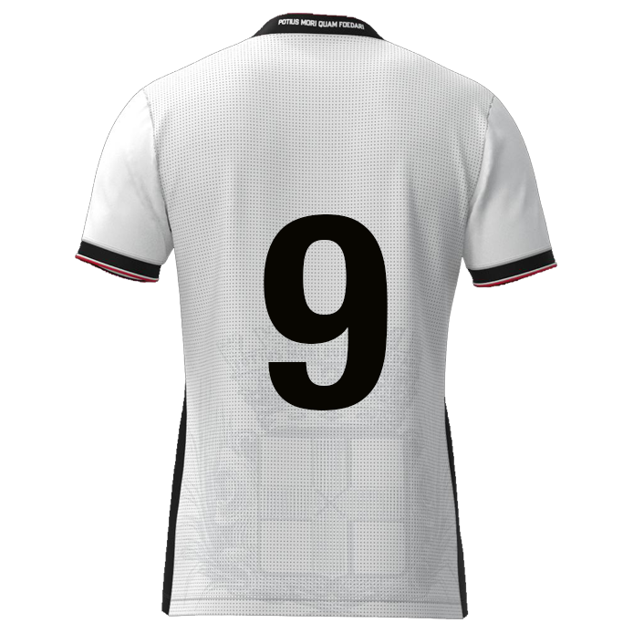

Slide 2

Browse
Foto
DATE: DD-MM-JJJJ
Player name
DD/MM/YYYY: Game / Training
DD/MM/YYYY: Game / Training
DD/MM/YYYY: Game / Training
DD/MM/YYYY: Game / Training
DD/MM/YYYY: Game / Training
DD/MM/YYYY: Game / Training
DD/MM/YYYY: Game / Training
Composure
xx
xx%
Offensive positioning
Link up play
Offensive headers
Powerplay
Flair
Determination
xxxx
Finisher nr. 09
9
11
7
xxxx
8
10
6
xxxx
xx
xx
xx
xx
5
2
4
3
xxxx
1
xxxx

Slide 3
F#9 | Rating | Multiplication factor | Result
Composure | 0 | 1,1 | 0
Offensive positioning | 0 | 1,1 | 0
Link up play | 0 | 1 | 0
Offensive headers | 0 | 1 | 0
Powerplay | 0 | 1,1 | 0
Flair | 0 | 1,1 | 0
Determination | 0 | 1 | 0
 |  | Average rating | 0,00

Slide 4
Finisher #09
9
11
7
Composure
Flair
10
8
Offensive positioning
6
5
2
4
3
Link up play
Powerplay
Determination
1
Offensive headers

Slide 5
Composure
Offensive positioning
Link-up play
Offensive headers
“Calm and controlled under
pressure, to make good decisions
and execute skills accurately”
“Ball receptions in halfspace
and/or final third”
“Combine effectively in short passes, movement, and coordination to create attacking opportunities”
“Shot with the head
from open play”
Danger zones
Overview
(Body)position
Goal oriented
Goal attempts
Between the posts
End result
?
Space recognition
Scanning
Awareness
Overload / 3rd man
Reachable
Rotating
Areas of play
?
Positioning
In duel / in position?
Timing
Overview
Body part
Frequency?
End result
?
Positioning
In duel / in position?
Timing (jump)
Power & accuracy
Direction (header)
Preference (side)
Frequency?
End result
?
Power play
Flair
Determination
“Attempts by physical strength and forceful challenges to dominate opponents in duels”
“Ability and confidence to perform creative, skillful, and often unexpected actions with the ball”
“Showing strong will, persistence, and commitment to succeed, even in difficult situations”
Strong body part
Groundduels
Aerial duels
Timing
Preparation
Frequency?
End result
?
Appearance
Confident
Present
In control
Excited
Boost at heat of the moment
?
Emotion control
Behaviour (by result)
Mourning
Inspiring others
Never give up
Fight until the end
Always 100%
?

Slide 6



Slide 7
Offensive
positioning

